Slide 1

Reef Ad Hoc Sensor Network
Continued from Nigel Sim (2003) and Steven Sloots (2004)
Li-Wen Yip
Computer Systems Engineering
James Cook University
Supervisor: John Wicking
Notes:
0:20
Greeting + Introduction

Slide 2
Summary
Ad-hoc networking overview
Problem Overview
Previous work
Project Scope
Literature Review
Progress
Outcomes
Questions
Notes:
0:30 (0:50)

Slide 3
Ad Hoc Networks
Main Entry: ad hoc
Function: adjective
1 a : concerned with a particular end or purpose
b : formed or used for specific or immediate problems or needs
<ad hoc solutions>
2 : fashioned from whatever is immediately available
Source: Merriam Webster Online Dictionary – www.m-w.com
In computer networking, ad-hoc is a connection method for wireless networks that requires no base station — devices discover others within range to form a network for those computers.
Source: Article on “ad hoc” at en.wikipedia.org
Notes:
0:20 (1:10)
Definition of ad hoc

Slide 4
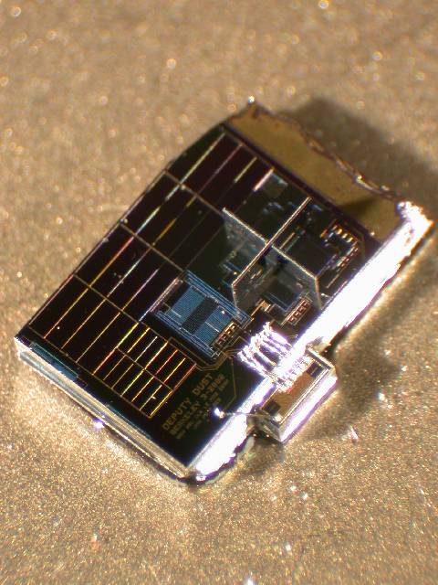
What is an Ad-Hoc Sensor Network?
Independent nodes forming a distributed sensing network.
Self-configuring
No fixed infrastructure or topology
Nodes contain
  Battery
  Radio
  Sensors
  Microprocessor
Static nodes
Low data rate
QoS not important
Existing solutions:
  Berkley Smartdust
  Crossbow Motes
Image Source: http://www-bsac.eecs.berkeley.edu/archive/users/warneke-brett/SmartDust/
Notes:
1:00 (2:10)
Explain the characteristics of an ad hoc network
Explain what makes an AHSN different to a MANET
Point out the picture of the Berkley Mote

Slide 5
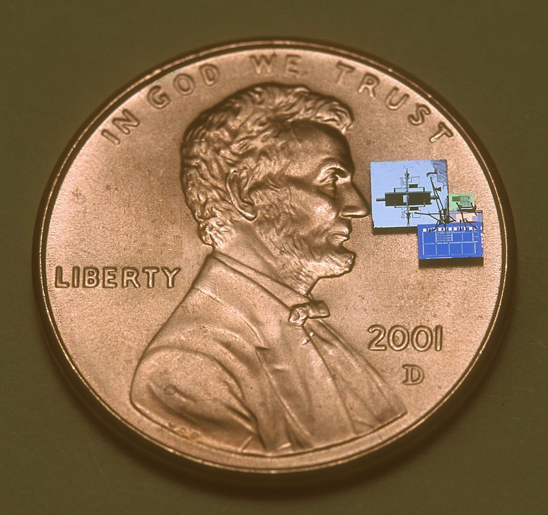
Berkley Motes
Image Source: http://www-bsac.eecs.berkeley.edu/archive/users/warneke-brett/SmartDust/
Notes:
Look how small it is!

Slide 6
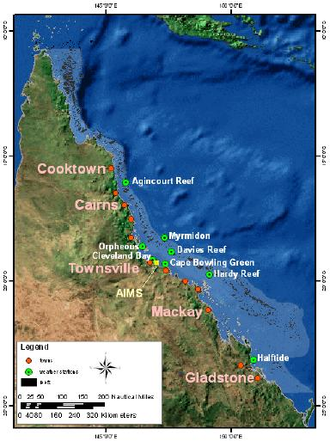
AIMS Reef Monitoring Network
Monitoring Stations
Data collection
  long-range radio links
  manual visits.
Replace with ad hoc sensor network.
Reduce
  power consumption
  maintenance.
Image Source: “Sensor Networking the Great Barrier Reef”,
Kininmonth et al, AIMS Tsv QLD.
Notes:
0:30 (2:40)
Explain how it’s going to be deployed on the reef
Explain why it’s being done

Slide 7
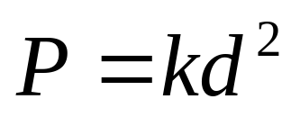
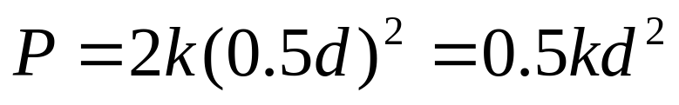
Multi-Hop Power Savings
d
A
B
0.5d
0.5d
A
C
B
Notes:
0:30 (3:10)
Explain how multi-hopping saves power
Mention how cancellation & scattering makes power 4th power

Slide 8
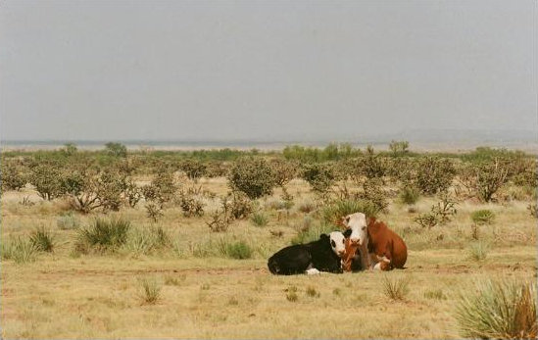
A different scenario…
Scenarios for existing technology:
  Small geographical area.
  Small hops (metres).
Scenario for this network:
  Very large geographical area.
  Large hops (kilometres).
  Remote locations.
Similar applications:
  Remote monitoring of
  water trough levels
  on a cattle property.
Notes:
0:30 (3:40)
Explain what makes this application different to existing technology

Slide 9
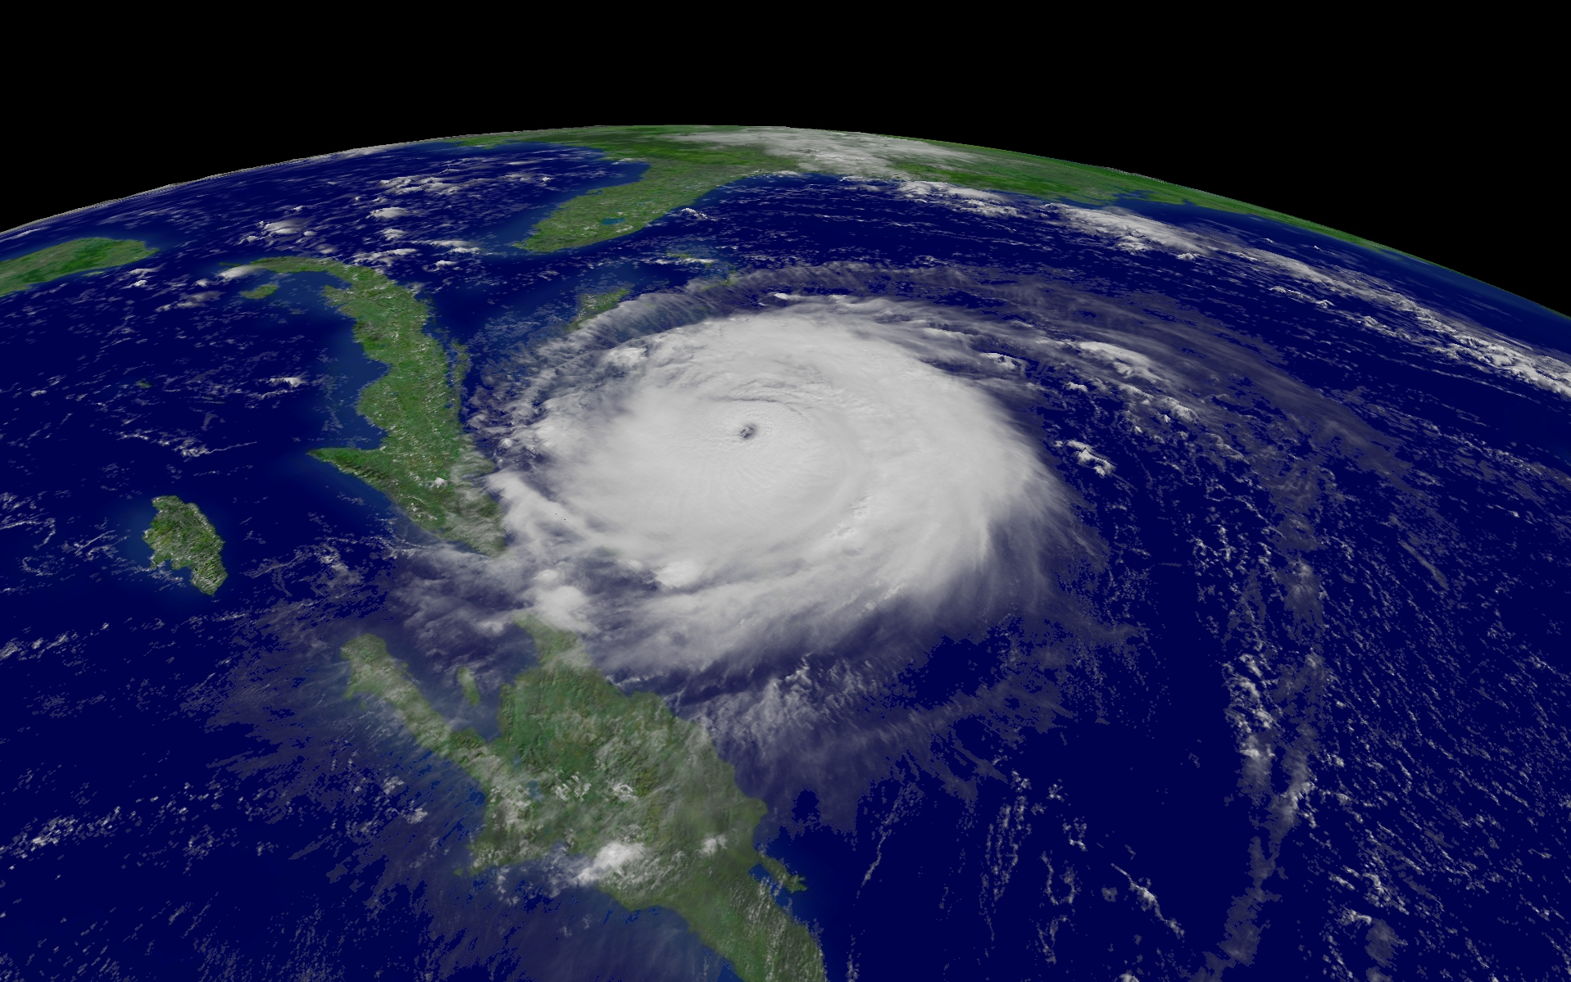

Requirements and Challenges
Minimal power consumption
  Maximise battery life
  Minimise maintenance
Robust
  Varying link quality
  Nodes crashes
  Temporary partitions
Scalable
  Maintain performance in larger networks
  Minimise cost-per-node.
Notes:
0:30 (4:10)
Mention techniques for saving power
Why does it matter when you can use solar panels?
Explain network dynamics which the network must cope with (cyclone)

Slide 10
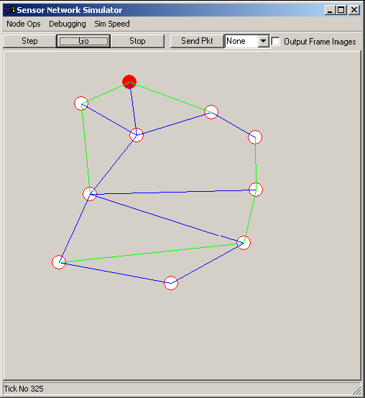
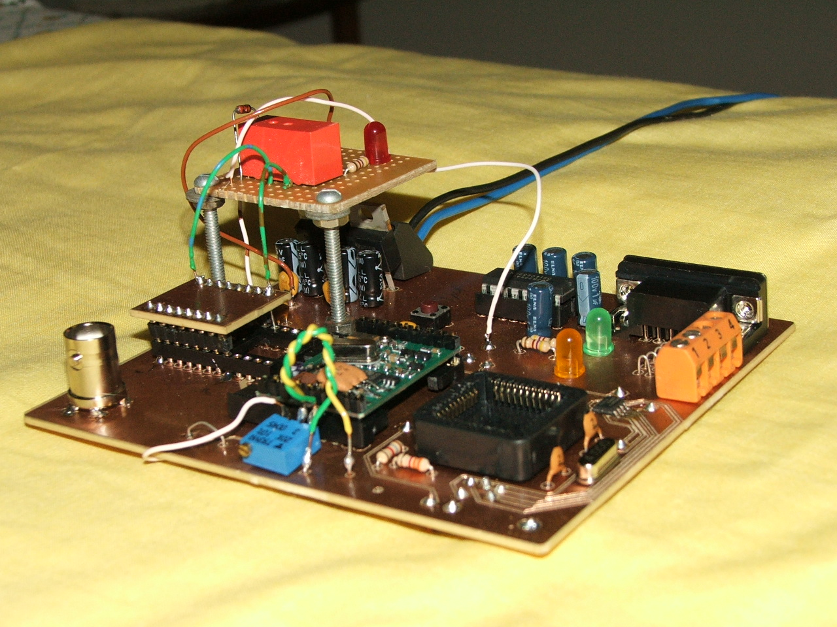
Previous Work
2003 – Mr Nigel Sim
  Basic Hardware
  Research efforts focused on simulation
2004 – Mr Steven Sloots
  New Hardware
  Power Efficient Routing Protocol (DSR)
Notes:
0:30 (4:40)
Nigel laid groundwork
Sloots improved on this and implemented routing algorithm

Slide 11
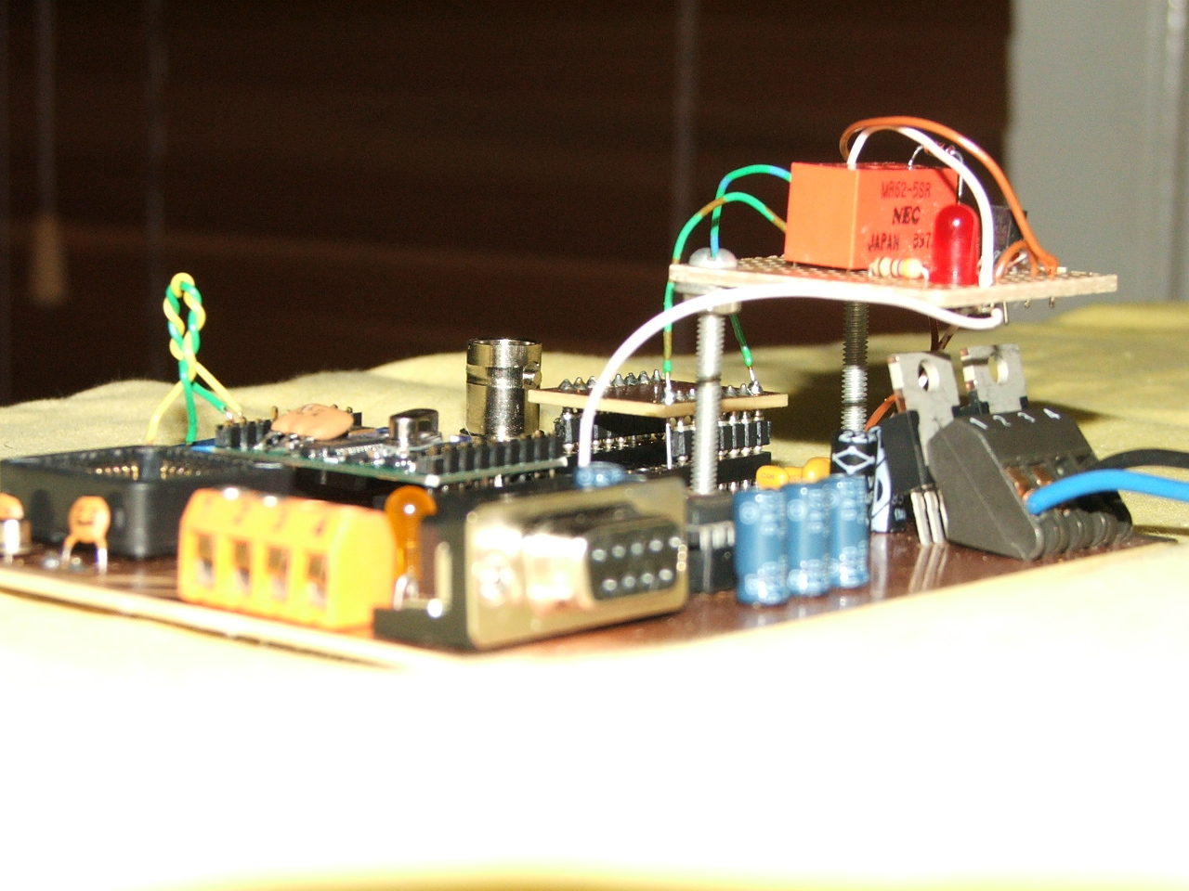
Project Scope for 2005
Hardware improvements
Addressing Protocol
Wakeup protocol
(if time allows)
Larger scale testing
Notes:
0:30 (5:10)
To be discussed in the following slides

Slide 12
Addressing Protocol
#1 priority is maximising energy efficiency
  Control overhead
  Addressing overhead
General Goals for Addressing Protocols
  Dynamic Configuration
  Timely allocation of unique addresses
  Robustness
  Scalability
Notes:
1:00 (6:10)
Describe how the addressing protocol can be made more energy efficient
Describe other goals

Slide 13
Addressing Techniques
Mitosis
  Nodes control address spaces
  Low overhead
  Robust
  Address depletion problem
    Proactive vs Reactive
Other Techniques
  Duplicate Address Detection
  Leader Based
A
B
D
C
Notes:
1:30 (7:40)
Describe protocols, their advantages, and disadvantages
DAD - like crossover cable, not good in a large network
Leader based - like DHCP, one node elected as leader, easier, unfair mem reqs on the leader node

Slide 14
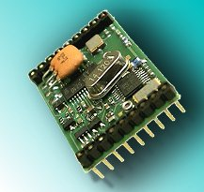
Wakeup Protocol
Allows nodes to sleep
Why sleep the nodes?
  X2010
    Rx - 7mA (typ)
    Tx - 8mA (typ)
  PIC – 2.5mA (typ)
Significant power savings
Notes:
0:30 (8:10)

Slide 15

Wakeup Mechanisms
Asynchronous wakeup
  Individual overlapping wakeup schedules
  Easy to implement
  Robust
Other techniques:
  Scheduled Rendezvous
  Out-band signalling
Notes:
Out band - separate low power channel.
Rendezvous - synchronization is difficult in multi-hop networks
Asynchronous - copes well with ad hoc network dynamics

Slide 16


Hardware
PIC 18C452
X2010 Radio Transceiver
AD8639 VGA
Bypass Relay
DS1302 Timekeeping Chip
PIC18C452
Sensor Data
Rx/Tx
X2010 Radio Transceiver
AD8639 VGA
SPDT Relay
Notes:
0:40 (8:40)

Slide 17

Progress
Working Prototype
Lit Review
Complete
Ready to start
building and coding
Thesis Draft Complete
Initial
Investigation
Implementation
& Debugging
Evaluation
& Reporting
Research
Design & Simulation
Exams
Semester 1
1st September
1st March
1st April
1st May
1st June
1st August
1st July
Semester 2
Vacation
Exams
Notes:
0:30

Slide 18
Outcomes
Minimum:
  Dynamic Addressing Protocol Developed
  Wakeup Protocol Developed
  2 communicating, functional nodes
Expected:
  Working Addressing Protocol Implemented
  Working Wakeup Protocol Implemented
  Testing with several ( >2 ) nodes
Notes:
0:30

Slide 19
Questions
If there are no stupid questions, then what kind of questions do stupid people ask?
Do they get smart just in time to ask questions?
Scott Adams (1957 - )

